Slide 1


Real State and Criminality
Presented by
Amelia Acuna

Slide 2
Project Introduction
It was intended to analyze the association between real estate prices and crime rates in various U.S states and cities.
"How do crime rates influence real estate values in different U.S states and cities?" directs the inquiry, attempting to measure the effect of crime on property prices.

Slide 3



Web Scraping
Data Acquisition
Web Scraping is a technique used to collect textual data from websites that can be done through manual selection or it can involve automated crawling.
Depending on the website and its content one should choose between static or dynamic scraping.
For this study, automatic and dynamic scraping using Python targeting real estate from Zillow is used.
Application Programming Interface (API)
API allows the user to request data from third-party providers. To retrieve data related to crime in the United States, the API used for this study is ''FBI Crime Data API'
Dataset
The dataset that contains crime rates for cities in United States.
For this study, the following variables will be taken into account: state, city, population, violent_crime, prop_crime or property crime, and burglary

Slide 4
STRUCTURED DATA
From the web scraping the extracted real estate listings contains attributes like price, number of bedrooms, bathrooms, square footage which is well-structured and fits naturally a fixed schema.
ACID OVER BASE
Based on the need for reliable, consistent and accurate analysis it seems to be more appropriate to choose an ACID approach
Atomicity, Consistency, Isolation, Durability.
Data
Storage
DATA
RELATIONSHIPS
It handles multiple related data fields efficiently and in a straightforward manner.
COMPLEX QUERIES
MySQL was chosen as it handles joins efficiently due to their relational nature and is less cumbersome when working with operations that require calculation over multiple rows.

Slide 5









Data Processing and Enrichment
Data Processing Techniques:
Merging Enrichment and Merging:
Data Cleaning and Standardization:
Enhancing with Kaggle Dataset:
Duplicate Management: Check id_location for property data, state existence for crime data.
Error Handling: Commit transactions after new record insertions.
Missing Data Strategy: Assign 'None' for missing property data, '0' for absent crime data keys.
Source Tables: web_scrapper_table (Real Estate Data from Zillow), api_table (Crime Data).
Process: Join operations in MySQL to combine tables.
Result: Integrated dataset imported into a Pandas DataFrame for analysis.
State Names: Convert state abbreviations to full names for consistency.
City Names: Extract using regex from location fields.
Focus: Ensure uniformity and clarity in geographical identifiers.
Integration: City-based crime rates added from Kaggle.
Column Management: Removal of irrelevant columns (e.g., 'id') to streamline data.
Population Data: Clean and convert to float for accurate numerical analysis..

Slide 6
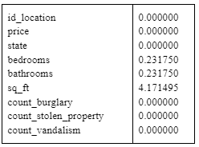
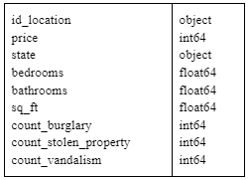
Data Quality
The quality of the data was assessed mainly through a completeness check and consistency verification.
Completeness
Consistency
The percentage of non-null values for each column was estimated with this line of code:
100 - web_scrapper_api_property_data_df. \ notnull().mean() * 100
The web_scrapper_api_property_data_df.dtypes function checks the data types of each column in the main DataFrame. This phase ensures that each column contains the expected type of data, which is required for accurate analysis.
Key columns such as price and state, among others, are fully completed, promising that the wanted analysis of these factors will not be hindered for the available data.

Slide 7
Data Quality
The quality of the data was assessed mainly through a completeness check and consistency verification.
Uniqueness
Accuracy
As a preventive and necessary measure before inserting data into the tables, there are some instances that uniqueness is verified:
Range Checks: Verification that the data related to price falls within expected ranges (e.g., no negative values, prices equal to 0 or below 10,000 USD)
11 rows were dropped with a DELETE query in the corresponding table.
web_scrapper_api_property_data_df[web_scrapper_api_property_data_df['price'] <= 10000]['price'].count()
web_scrapper_table: Should first verify whether id_location already exists before inserting a new property.
api_script.py: Checks if state is already present before fetching and adding new data.
print(df.duplicated().sum()) was 0
The results of these two lines are the same : web_scrapper_api_property_data_df.nunique() len(web_scrapper_api_property_data_df)

Slide 8
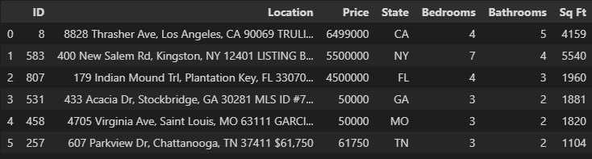
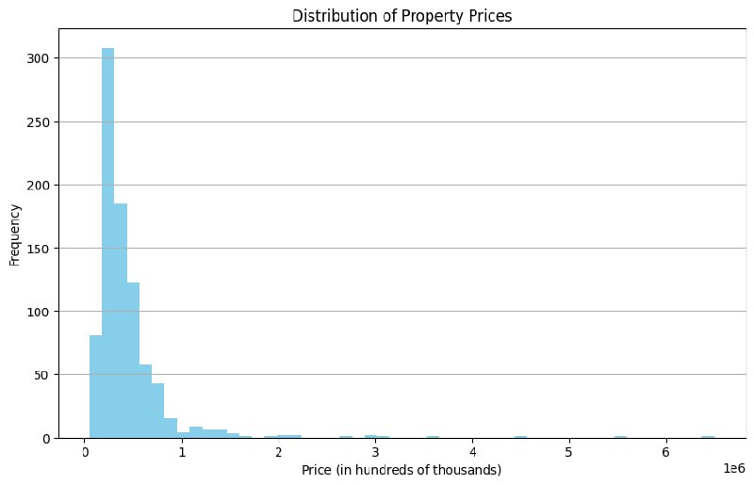
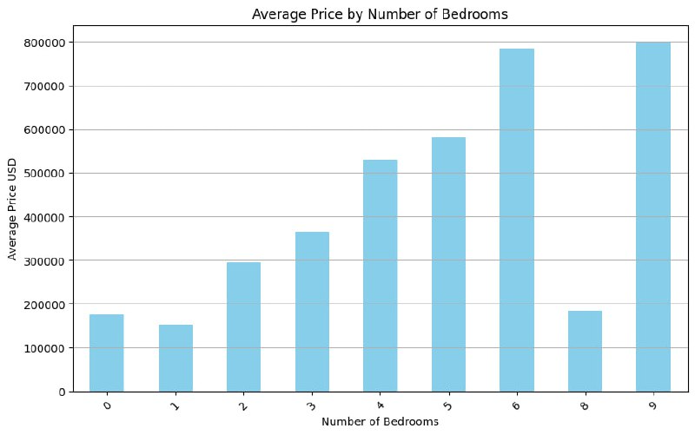
Exploratory Analysis
Top most expensive and cheapest properties from the real estate listing were retrieved
Average price of property depending on the number of bedroom (excepting 7 as it seems to be affected by outliers)
Distribution of property prices

Slide 9
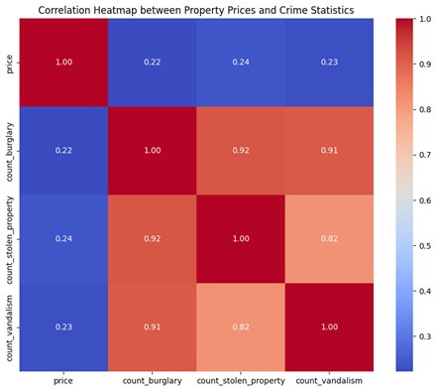
Correlation Heatmap between Propery Prices and Crime Stadistics
The values suggested a weak positive correlation (between 0.22 and 0.24), meaning that as the crime counts increase there is a slight tendency to get higher prices.
This could be counterintuitive, but due to the lack of more granular data one may suggest that higher property values are frequently seen in cities, which also have higher absolute crime rates.
The correlation between the types of crimes studied is high (between 0.82 and 0.952) indicating that high rates of one crime represent high rates of others too.

Slide 10
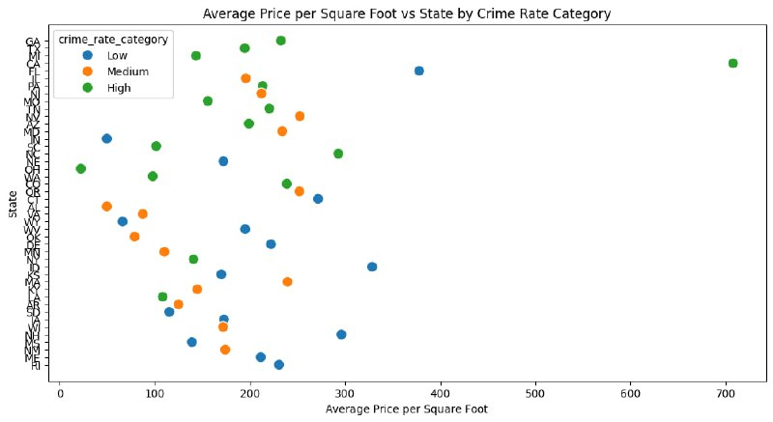
Average Price vs State by Crime Rate Category
To answer the question "How does the average price per square foot vary among states with different crime levels?", the states were categorized into 'Low', 'Medium', and 'High' crime rates based on totals of crime count.
The scatter plot below shows that states with greater crime rates do not always have lower average property values per square foot. There is not a clear, consistent pattern where states with lower crime rates have higher property values

Slide 11
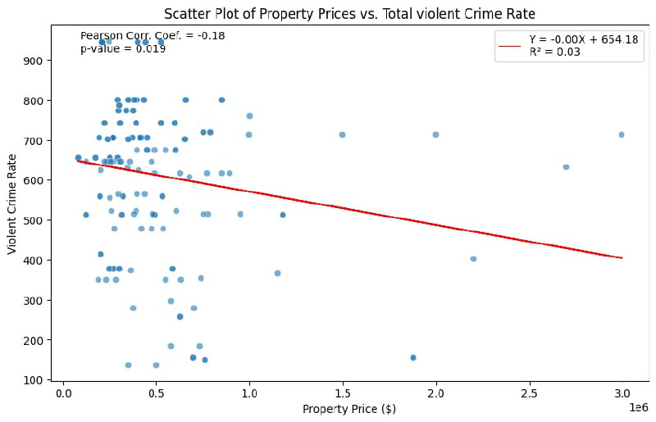
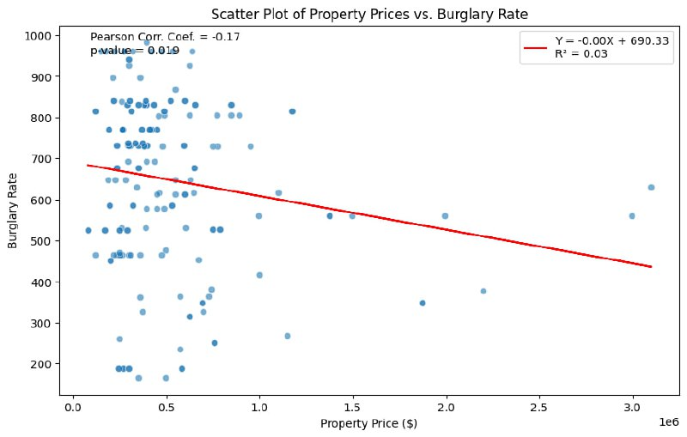
Property Prices Vs Violent Crime Rates Vs Burglary
Overall, while the graphs show a statistically significant association, the actual strength of the relationship is relatively low and it has minimal practical implications due to its low R² value. It implies that variables other than violent crimes and burglary rates have a substantially larger role in influencing the property price.

Slide 12
Conclusions and
Improvements
Minimal correlation observed between property values and crime rates.
Data Granularity and Interpretation:
Crime Data: State and city level.
Property Data: More detailed, e.g., neighborhoods or specific addresses.
Differences in granularity affect the accuracy of correlation interpretation.
Example of limitation: Properties in high-crime areas of low-crime cities may still have high values, demonstrating the need for more localized crime data.
Recommendations for Future Research:
Acquire more granular crime data for a precise analysis.
Consider additional variables for a comprehensive understanding of property value determinants.

